Slide 1

STAYING MARRIED
Family seminar
14th October 2017

Slide 2

Outline of the seminar
Intimacy
Humour in marriage
Conflict resolution in marriage
Coffee break
Dealing with broken expectations
Remain committed to your marriage

Slide 3
Section 1: Intimacy
AP Johanna

Slide 4

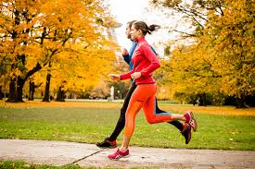
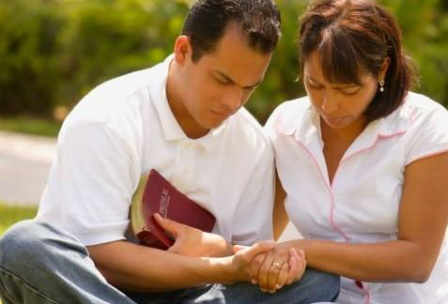
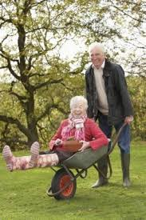
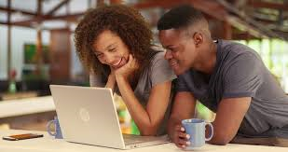
Intimacy = Into me See
10 Types of Intimacy in Your Relationship

Slide 5
Intimacy does not happen by magic
It is built over time. Cor. 14:1 “Pursue love”.
“We just don’t feel connected”
Intimacy is not an accident. It is result of what you do!
Building blocks:
Acceptance, respect, openness
Honesty and compassion
Time you spend together
Forgiveness
Physical touch

Slide 6
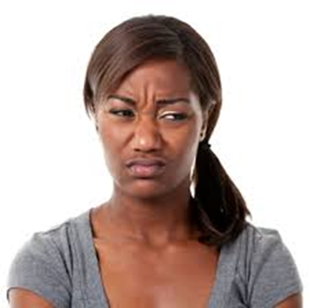


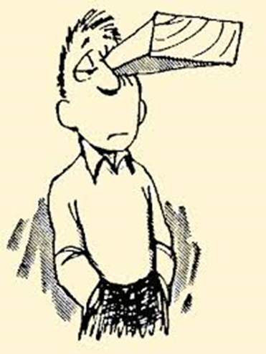
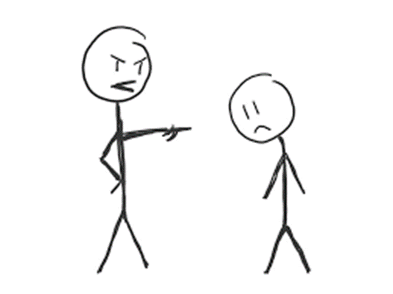
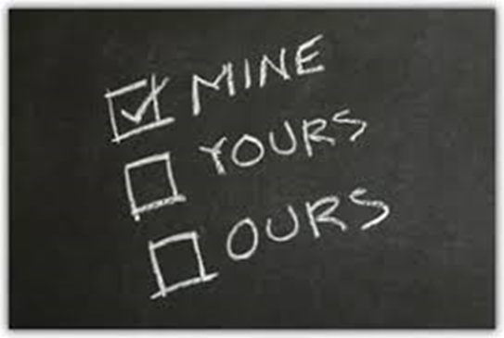
Intimacy breaking attitudes:
Controlling
Judgemental
Critical
Sarcastic
Unforgiving
Abusive
Selfish
Disrespectful

Slide 7
Idealizing intimacy ”Conflict is bad”.
- Learn the art of disagreeing well while still sending the msg: ”I love you even i disagree. I’ll still accept you, even if you don’t accept all of my ideas”
“We Can Only Have the Same Interests”
“I Must Marry Someone Who is Hot!”

Slide 8
Why is Emotional Closeness sometimes so hard to establish?
There are lots of reasons we struggle to get connected emotionally with ourselves and others. Here’s a few reasons we all struggles with:
Fear of rejection
Unfamiliarity with our own feelings, needs and wants
Not knowing how to express our inner feelings, needs, and wants with another person. Without meaning to, we often expect others to “just know”
No model growing up that being vulnerable with others is safe
Bride. Without choosing genuinely value your spouse’s personality, opinions, thoughts and ideas it is impossible to have emotional intimacy.

Slide 9
…Practices…
Holding hands
Regocnizing and expressing motions: I feel calm, when ….
Give and receive praise: 2 things you love, like, appreciate in your spouse.
Intimacy for sex: eyes open, lights on, nurturing conversation.
Eye contact

Slide 10


Slide 11
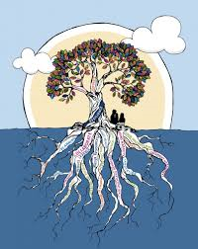
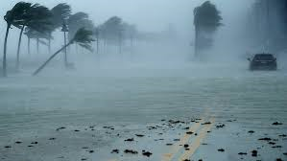
Secret to maintain emotional intimacy in long term relationship?
Building up your resilience

Slide 12

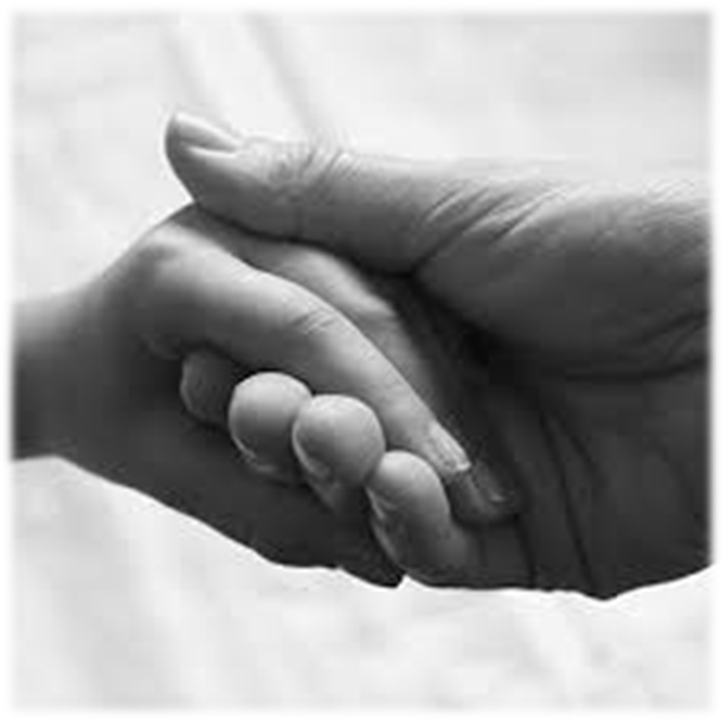
Emotional intimacy florishes in an atmosphere of safety
We open up, we take risks with person who is accepting, caring and compassionate

Slide 13
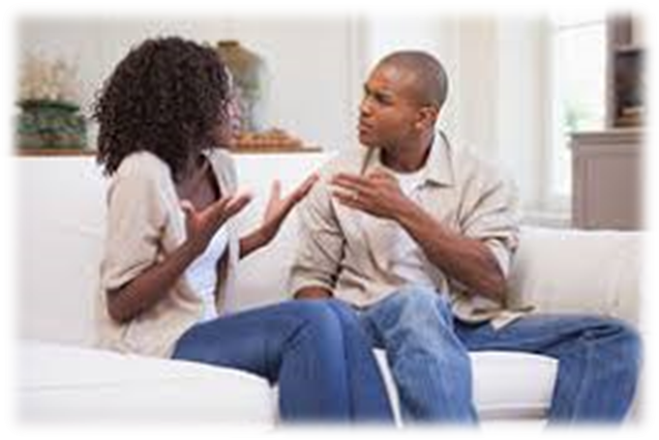
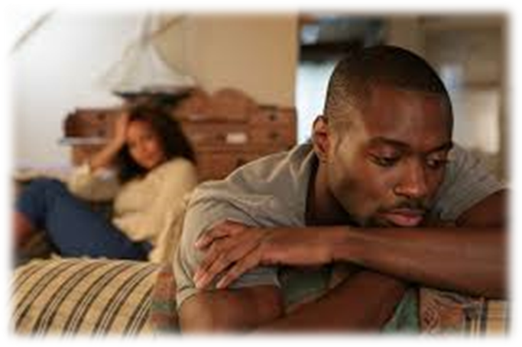
The problem is that no one is completely reliable when it comes to these qualities.
Most people have bad days, when they may be irritable or grumpy.
What happens to safety when the other person’s acceptance and caring goes away?

Slide 14
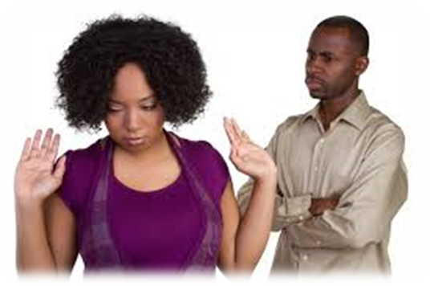
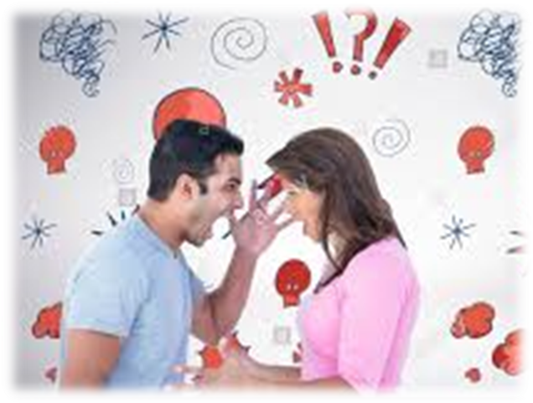
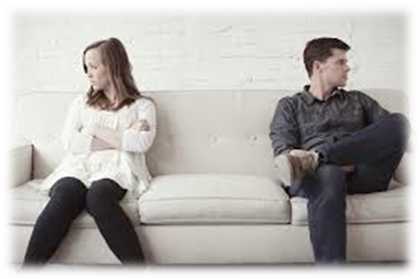
the moment we are triggered into fear — fear of rejection, of domination, of abandonment, of losing ourselves or losing the other.
We abandon ourselves and become reactive — getting angry, complying, withdrawing, resisting, blaming, defending, explaining, attacking and so on.
None of these behaviors create inner safety, nor do they contribute to relationship safety.

Slide 15
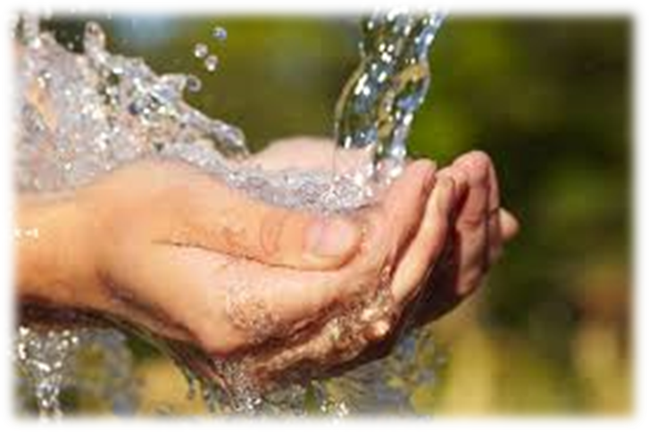
Our sense of safety needs to come from within as well as from without
We need to become
strong enough within to not take another’s bad day personally.
centered enough within to stand up for ourselves, and take loving care of our feelings when another gets angry or blaming.
powerful enough within to stay openhearted in the face conflict.

Slide 16

How do we learn to stay connected, openhearted and non-reactive in the face of fear and conflict?
The key is to regularly staying connected with the Comforter, Holy Spirit, so that when the fear and conflicts arise, you have that source available to you and can bring that comfort to your painful feelings. None of us can stay open by ourselves.
When our ego — our wounded self — is activated by fear and conflict, we must be able to turn to a source of spiritual power, Holy Spirit, for the strength to not react with our learned defenses, and the strength to bring compassion to our painful feelings.

Slide 17
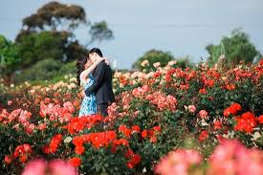
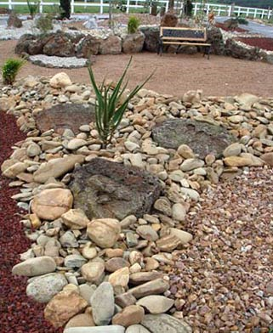
Good news!
There is so much you can do to increase intimacy!
Things to do are not difficult or complicated!
You decide what you bring into your garden!

Slide 18
References
10 Types of Intimacy in Your Relationship, Dr. Bruce and Karen McCracken (www.youtube.com/watch?v=Y3aDEbbzknc )
Emotional, Spiritual and Physical Intimacy in Relationships -- Dr. Douglas Weiss (www.youtube.com/watch?v=Y3aDEbbzknc )
THE BLOG 06/23/2014 What Really Creates Emotional Intimacy, By Margaret Paul, Ph.D. (https://www.huffingtonpost.com/margaret-paul-phd/what-really-creates-emoti_b_5521373.html )

Slide 19
Section 2: Humour in marriage
Deacon Peter

Slide 21
Section 3: Conflict resolution in marriage
Deacon Chris

Slide 23
Section 4: Dealing with broken expectations
Deaconess Charmaine

Slide 25
Section 5: Remain committed to your marriage
Min Natalja

